Slide 1

Snakes and Ladders OWASP Newcastle 24th November 2015

Slide 2
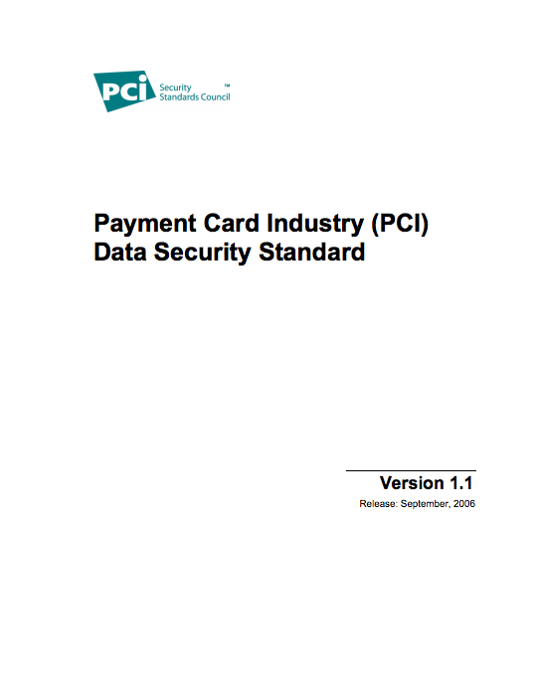

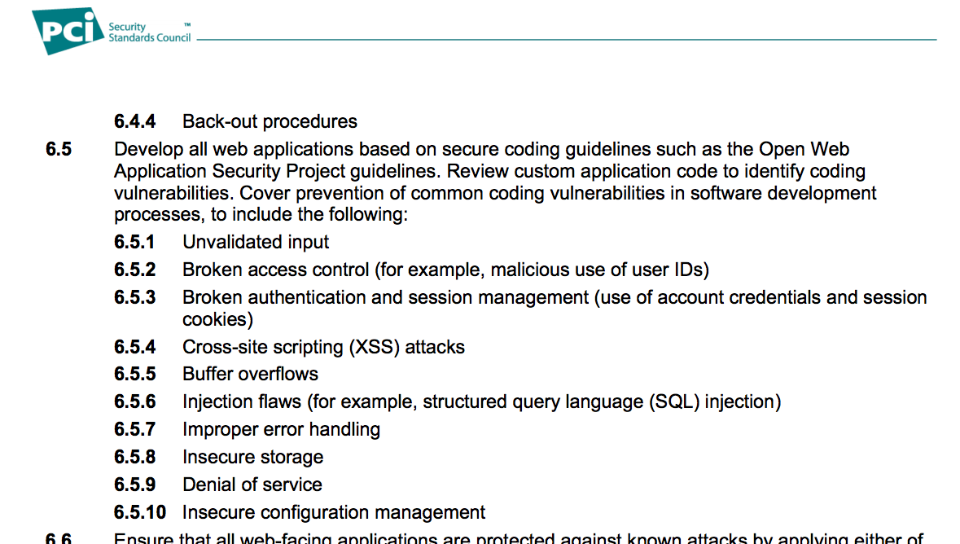
Web Risks
2013
17th September 2014
https://www.owasp.org/index.php/OWASP_Top_Ten_Project

Slide 3
Well-Known List
Top Ten Risks to Web Applications (2013)
A1 Injection
A2 Broken Authentication and Session Management
A3 Cross-Site Scripting (XSS)
A4 Insecure Direct Object References
A5 Security Misconfiguration
A6 Sensitive Data Exposure
A7 Missing Function Level Access Control
A8 Cross-Site Request Forgery (CSRF)
A9 Using Components with Known Vulnerabilities
A10 Unvalidated Redirects and Forwards

Slide 4
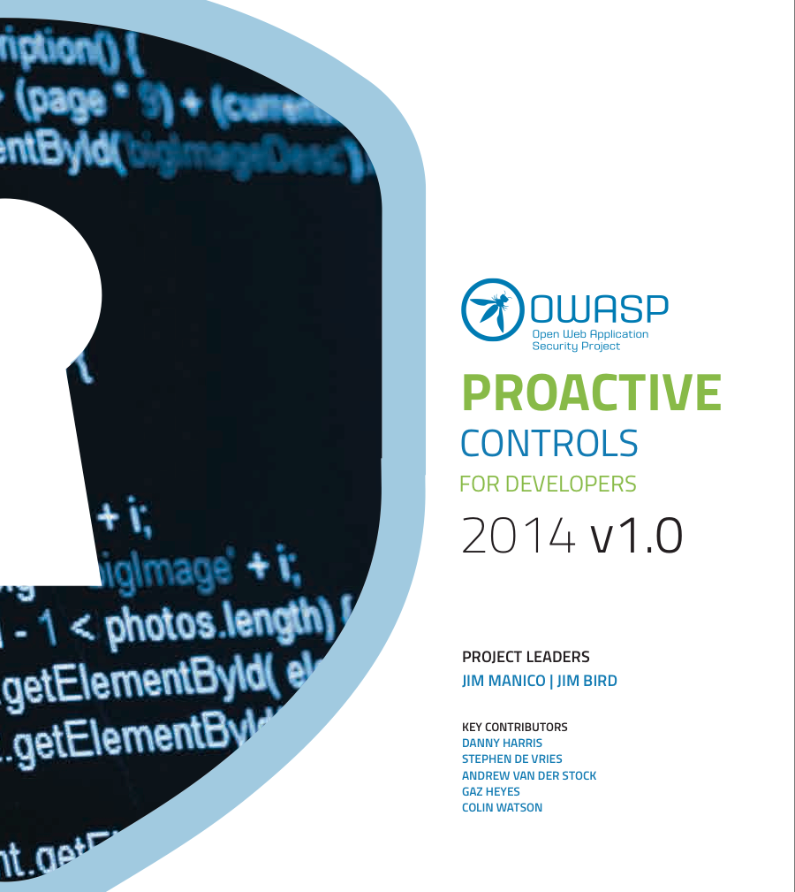
Proactive Controls
Version 1
10th March 2014
https://www.owasp.org/index.php/OWASP_Proactive_Controls (version 2 in progress, due end 2015)

Slide 5
A Better List
Top Ten Proactive Controls Web Applications
C1 Parameterize Queries
C2 Encode Data
C3 Validate All Inputs
C4 Implement Appropriate Access Controls
C5 Establish Identity and Authentication Controls
C6 Protect Data and Privacy
C7 Implement Logging, Error Handling & Intrusion Detection
C8 Leverage Security Features of Frameworks and Libraries
C9 Include Security-Specific Requirements
C10 Design and Architect Security In

Slide 6
Too Much Text!
Educate
Move from risks to controls
Make a game
Learn Adobe Illustrator
Christmas “cards”

Slide 7
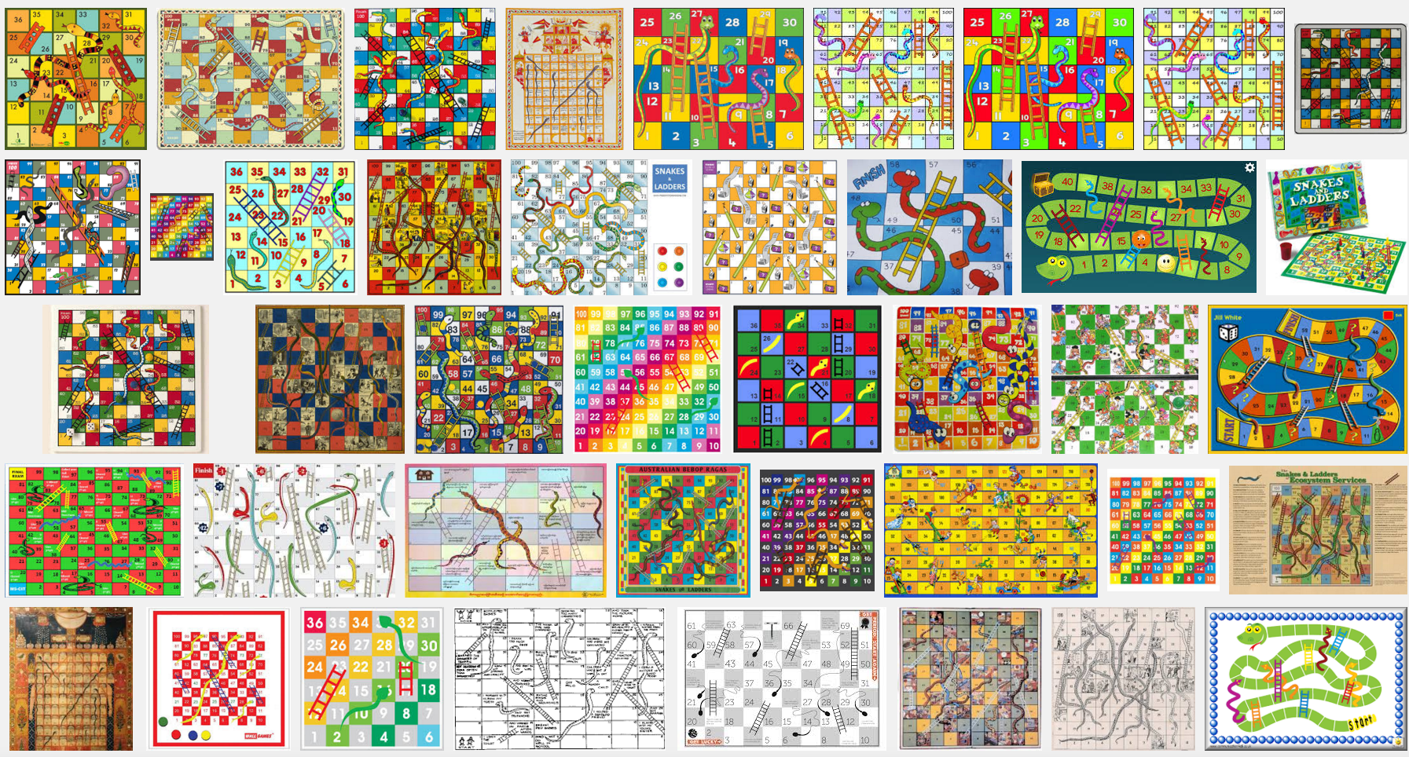
Designs, Trademarks, Etc

Slide 8
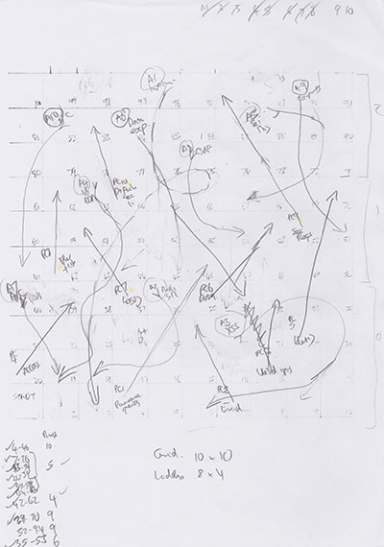
Concept
10 snakes
10 ladders
100 squares

Slide 9


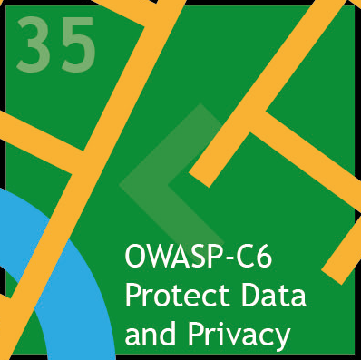
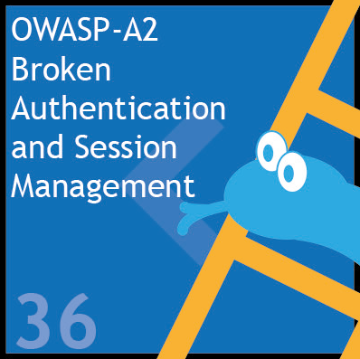
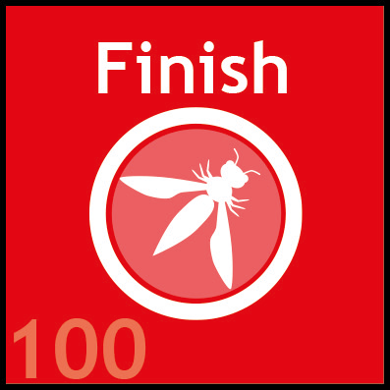
Flat Design

Slide 10
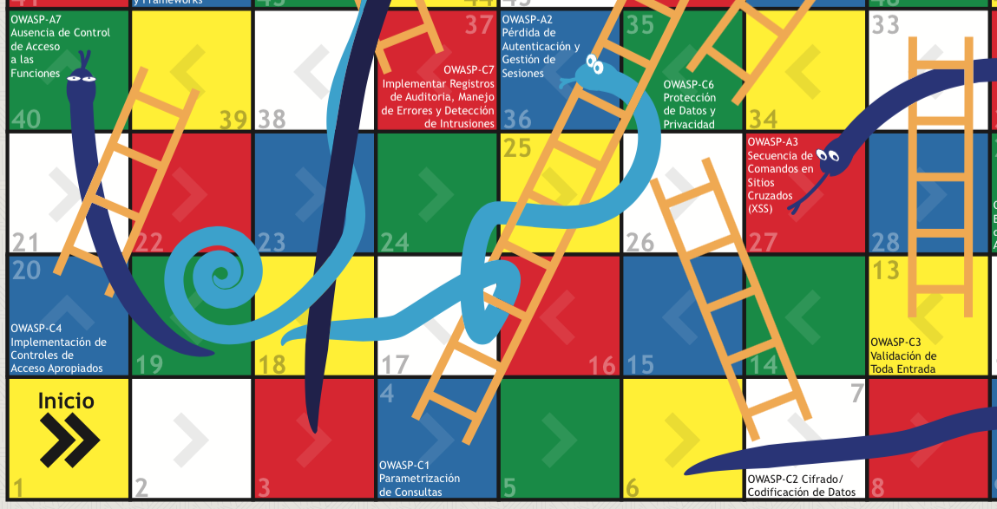
Web Applications: ES

Slide 11
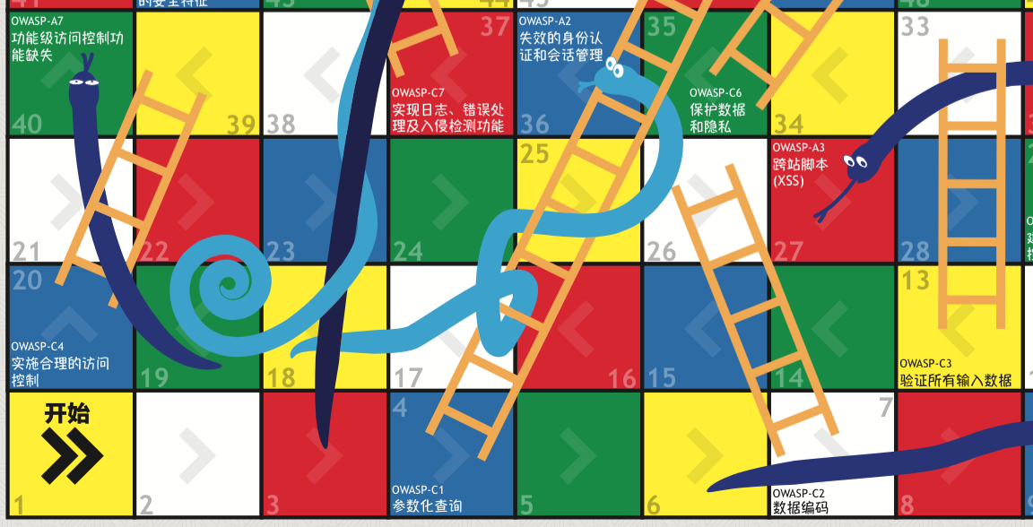
Web Applications: ZH

Slide 12
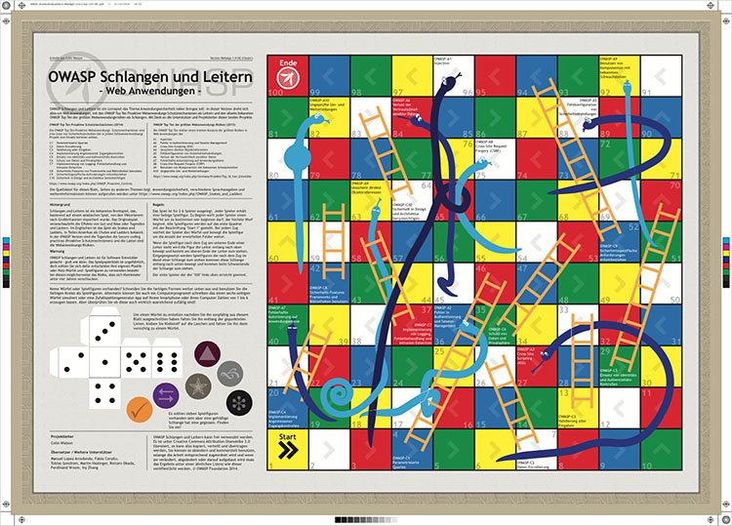
Web Applications: DE

Slide 13
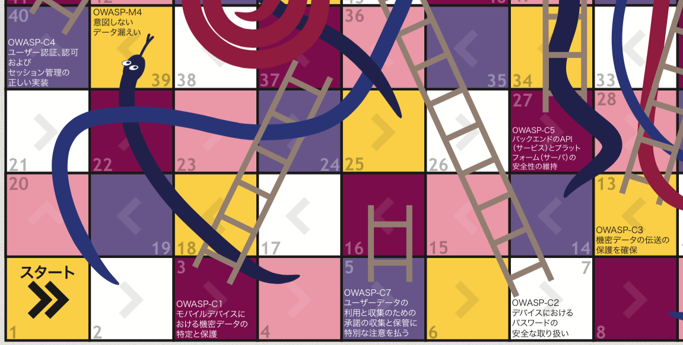
Mobile Apps: JA

Slide 14
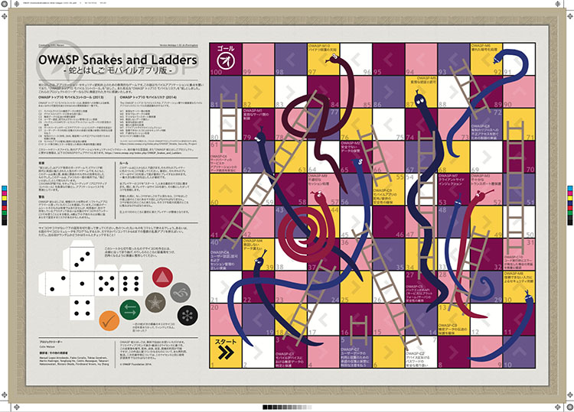
Mobile Apps: EN

Slide 15
Relationships 1/3
Is the placement of snakes and ladders meaningful?
Do nearby ladders fix adjacent snakes?
No
No

Slide 16
Relationships 2/3
Top Ten Risks
A1 Injection
A2 Broken Authentication and Session Management
A3 Cross-Site Scripting (XSS)
A4 Insecure Direct Object References
A5 Security Misconfiguration
A6 Sensitive Data Exposure
A7 Missing Function Level Access Control
A8 Cross-Site Request Forgery (CSRF)
A9 Using Components with Known Vulnerabilities
A10 Unvalidated Redirects and Forwards
Top Ten Proactive Controls
C1 Parameterize Queries
C2 Encode Data
C3 Validate All Inputs
C4 Implement Appropriate Access Controls
C5 Establish Identity and Authentication Controls
C6 Protect Data and Privacy
C7 Implement Logging, Error Handling and Intrusion Detection
C8 Leverage Security Features of Frameworks and Security Libraries
C9 Include Security-Specific Requirements
C10 Design and Architect Security In

Slide 17
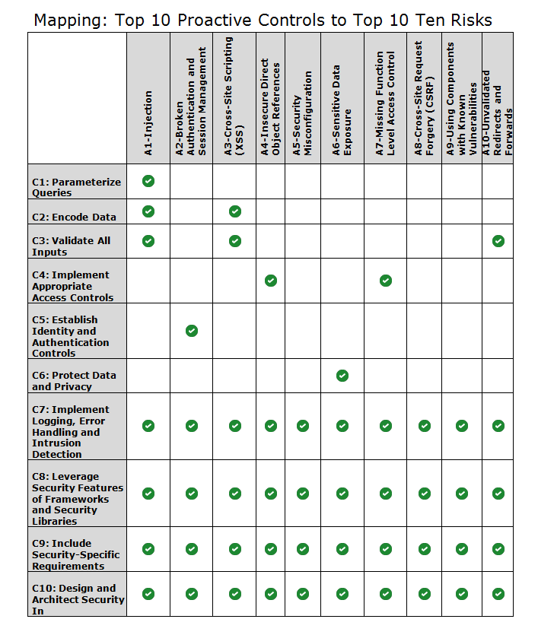
Relationships 3/3
https://www.owasp.org/index.php/ OWASP_Proactive_Controls#tab=Top_Ten_Mapping

Slide 18
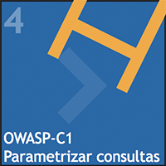
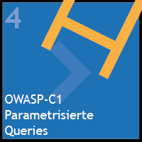
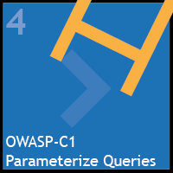
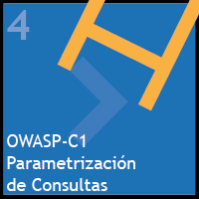
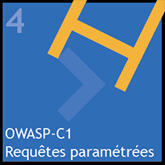

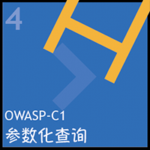
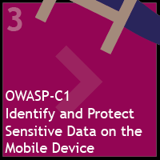
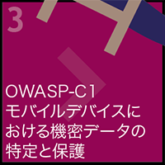
Print Your Own
Adobe PDF A2 print quality
Adobe Illustrator Source
Web Applications BR, DE, EN, ES, FR, JA, ZH
Mobile Apps EN, JA

Slide 19
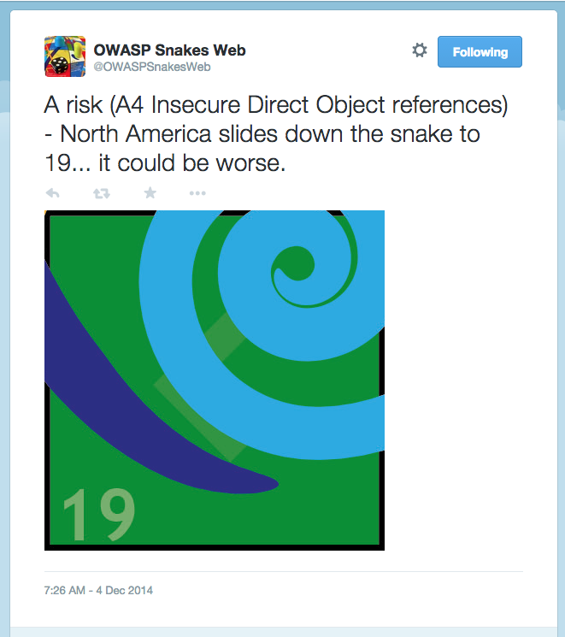
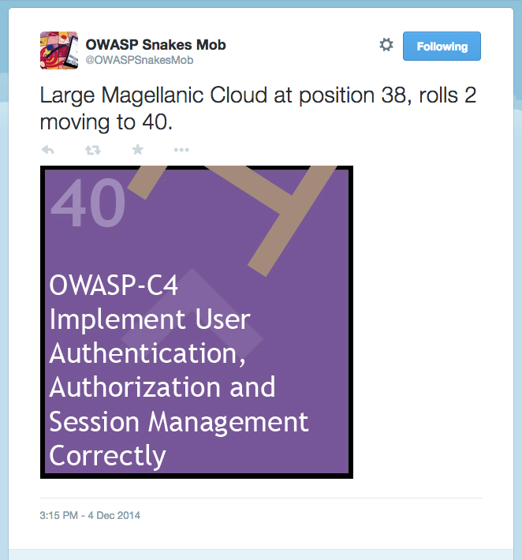
Twitter

Slide 20
From Lists to Threat Modelling
Not just 10 issues
Build security in from the start, and throughout processes
In depth application security requirements

Slide 21
Staying in Touch
Project page
https://www.owasp.org/index.php/OWASP_Snakes_and_Ladders
Mailing list
https://lists.owasp.org/mailman/listinfo/owasp_snakes_and_ladders
Twitter (Web) (Mobile)
@OWASPSnakesWeb @OWASPSnakesMob
Full world tour 2014-15
Singapore, Cambridge, London Docklands, London Shoreditch, Bristol, Amsterdam, San Francisco, Newcastle upon Tyne

Slide 22
Q&A
colin.watson@owasp.org

